Slide 1
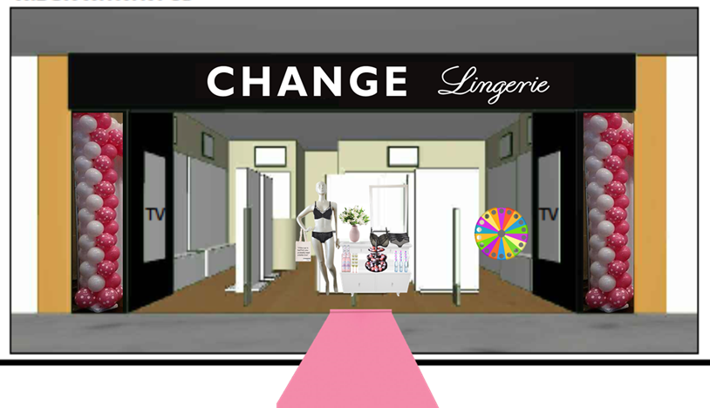

VM Guide Farsta, Stockholm

Slide 2


HAVE YOU RECEIVED ALL ORDERS
Have all orders been shipped to you
Ask Planning to confirm that the invoiced orders are corresponding to placed orders
Ask Order Management to confirm the amount of shipped pallets and time of delivery in your store.
Did all orders arrive in store and in good shape
Check you have received the correct amount of pallets
If pallets are missing contact Order Management sales@change.com follow up on phone/Skype
2

Slide 3
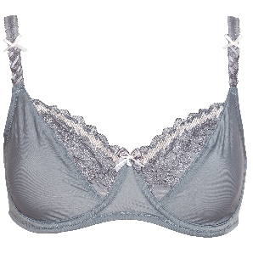

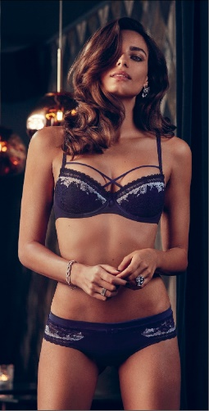
CHECK AND RECEIVE IN SYSTEM
Products
Receive these accordingly to manuals on the Intranet.
If items are missing please fill out claim sheet and return this to Order Management cc your planner and Country Manager
Marketing material
Check accordingly to your order list
If anything is missing, please make sure to pass the information on to the marketing team VM@change.com + your Country Manager follow up on phone/Skype
When you have checked all your marketing material, please make sure that you gather all together in one place ( for example a fitting room. )
3

Slide 4
Introduce the VM plan to the staff
Make sure that all the staff is having a copy of the VM drawing, so you all can see where the different brands should be displayed, and that you all have a clear view over the store.
Delegate the different tasks between the staff
Put product on hangers
Set up hooks and shelves in store
VM products in store
Dress mannequin and torso
VM products in closet
Set up marketing material in store
Prepare fitting room
Prepare Staff room
4

Slide 5
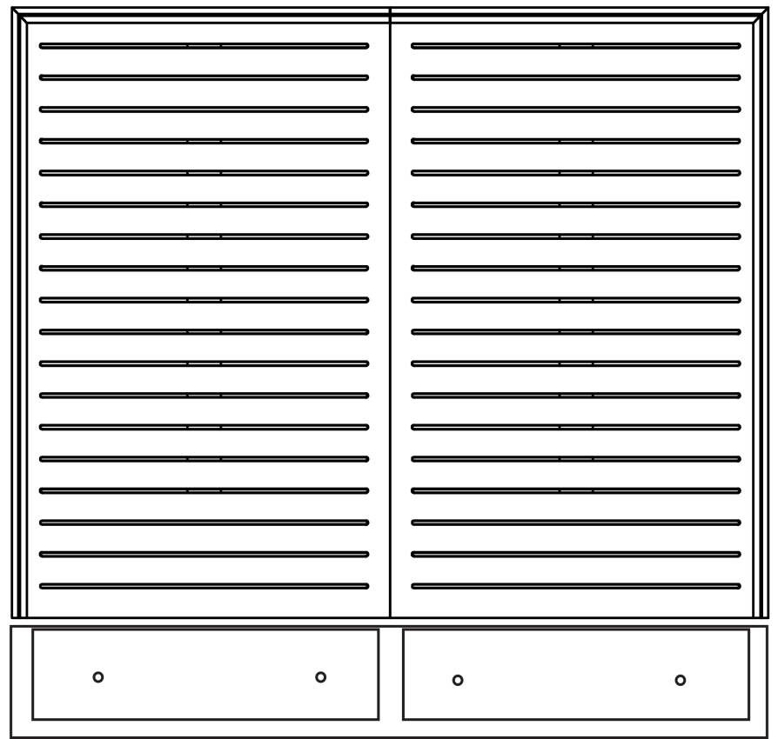
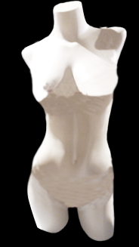
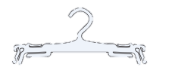
Set up hooks and shelves in store
Start with building the walls with hooks & shelves according to the given layout ( slides 11 - 19 )
Then build the floor modules with hooks after the given layout ( slides 11 - 12 )
Start to divide the different brands into their given area of the store. Check with your VM drawing.
5

Slide 6
Unpack products and do the VM
If the merchandise arrives NOT on hangers
Allocate 1 person or more to put on Hanger
Make sure you hang the products in the right place in the store accordingly to the VM drawing
Between 6-8 hangers per hook
Smallest size
The rest goes to stock
Place all accessories and stockings in acrylic boxes, and display those in the Basic area.
Dress the mannequins, torsos, busts etc.
6

Slide 7

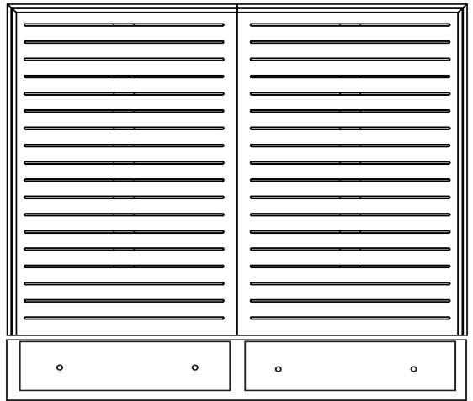
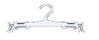

Unpack products and do the VM
If the merchandise arrives on hangers
Unpack the boxes with merchandise.
Make sure you hang the products in the right place in the store accordingly to the VM drawing
Start with the walls, then continue with the floor modules, and finally the racks.
Start to organize that the merchandise is hanging in correct size order
There are to be 6 to 8 products per hook
Organize in correct size order
We display the smaller sizes – the bigger sizes are to be on stock
The rest goes to stock
When you have finished one wall, check with the VM drawing that wall and drawing is corresponding with each other.
Place all accessories and stockings in acrylic boxes, and display those in the Basic area.
Dress the mannequins, torsos, busts etc.
7

Slide 8
VM with Marketing material
First you collect all the marketing material from where you gathered it in the beginning of the day.
Unpack all material and place it by its hanging location.
Start with displaying all the largest materials, such as bra guide, wall acrylic frames etc.
Continue with all the smaller formats such as A4, A6, A5.
After you have displayed all material in the shop and fitting room, double check that all frames and acrylic frames are having marketing material in them.
8

Slide 9
TV screen
Turn on the TV
Make sure that the TV has been installed so that the source for the Media player always will appear as default
Make sure the Media player is turned on
Make sure the Media player is turned connected to the Internet
Check the picture is shown in the right view (it should be portrait)
If the picture is shown in a wrong view, contact Project Manager
Check that the loop is as agreed upon with Marketing
If the content is not correct, contact Marketing@change.com and follow up on Skype/phone
9

Slide 10
Arrange your stock
Drawers below walls
Use the drawers for briefs. Make sure to keep the programs together so the program on the wall will have the matching briefs in the drawer below
Closet
Before adding merchandise to the wardrobes, you have identified which wardrobe / bar should be for which cup and size.
Before you identify which bar should carry which cup or size, check with your order list to know what you have received a lot in.
Add post it´s to each bar with what cup and size should be hanging on it.
Best selling sizes needs 1,5 bar
Less popular sizes 0,5 bar
Then you can start to hang the merchandise according to the post it´s, in cup and size.
Hang the bras in sizes and cups, don’t divide them into brands.
Do not put too many products on the bar, so you can easily remove a bra from the bar without struggling. Estimated amount of products are 40 pcs.
The lowest 2 bar in each wardrobe are for hanging briefs. These are being divided into sizes.
Swimwear should be in a separate wardrobe, and should be divided in cup and size.
One wardrobe is build with shelves, and this is for office supplies, paper bags etc.
Paper bags, hangers etc should be on the lowest shelves.
Office supplies should be from the middle shelf and up.
Note that the middle shelve has a different height so that binders can fit in it.
10

Slide 11
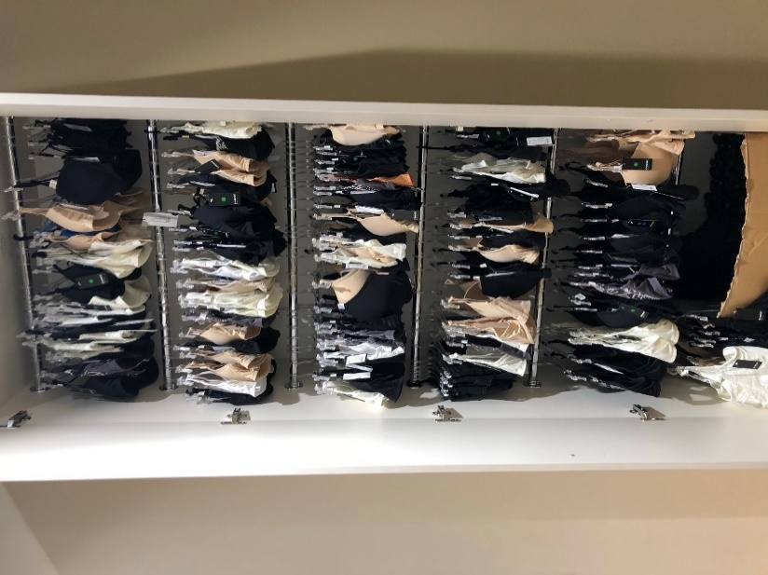
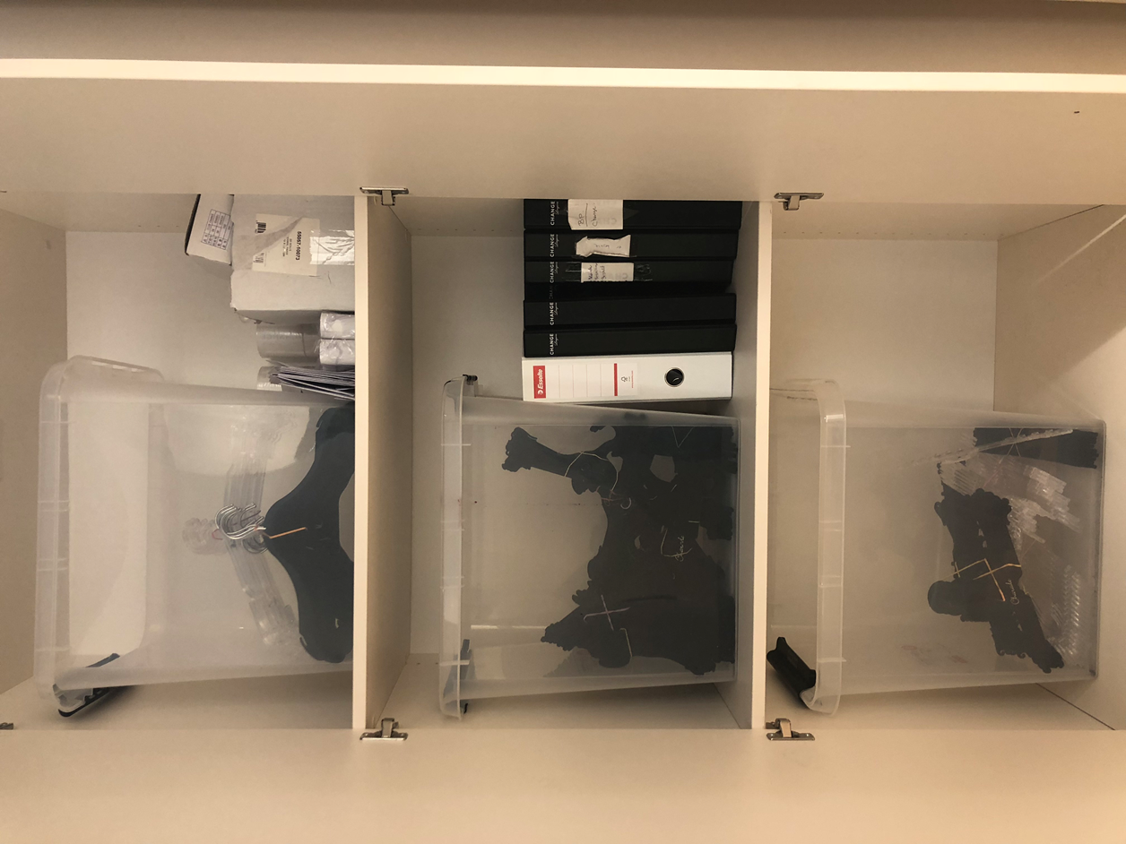
Arrange your stock
Drawers below walls
Use the drawers for briefs. Make sure to keep the programs together so the program on the wall will have the matching briefs in the drawer below
Closet
Before adding merchandise to the wardrobes, you have identified which wardrobe / bar should be for which cup and size. Remember to hang the bras in cup and size, NOT in program.
Before you identify which bar should carry which cup or size, check with your order list to know what you have received a lot in.
Add post it´s to each bar with what cup and size should be hanging on it.
Best selling sizes needs 1,5 bar
Less popular sizes 0,5 bar
Then you can start to hang the merchandise according to the post it´s, in cup and size.
Hang the bras in sizes and cups, don’t divide them into brands.
Do not put too many products on the bar, so you can easily remove a bra from the bar without struggling. Estimated amount of products are 40 pcs.
The lowest 2 bar in each wardrobe are for hanging briefs. These are being divided into sizes.
Swimwear should be in a separate wardrobe, and should be divided in cup and size.
One wardrobe is build with shelves, and this is for office supplies, paper bags etc.
Paper bags, hangers etc should be on the lowest shelves.
Office supplies should be from the middle shelf and up.
Note that the middle shelve has a different height so that binders can fit in it.
85 F
80 F
75 F
70 F
60-65 F
The idea is to be able to show the customer the full range in her size and cup.
11

Slide 12
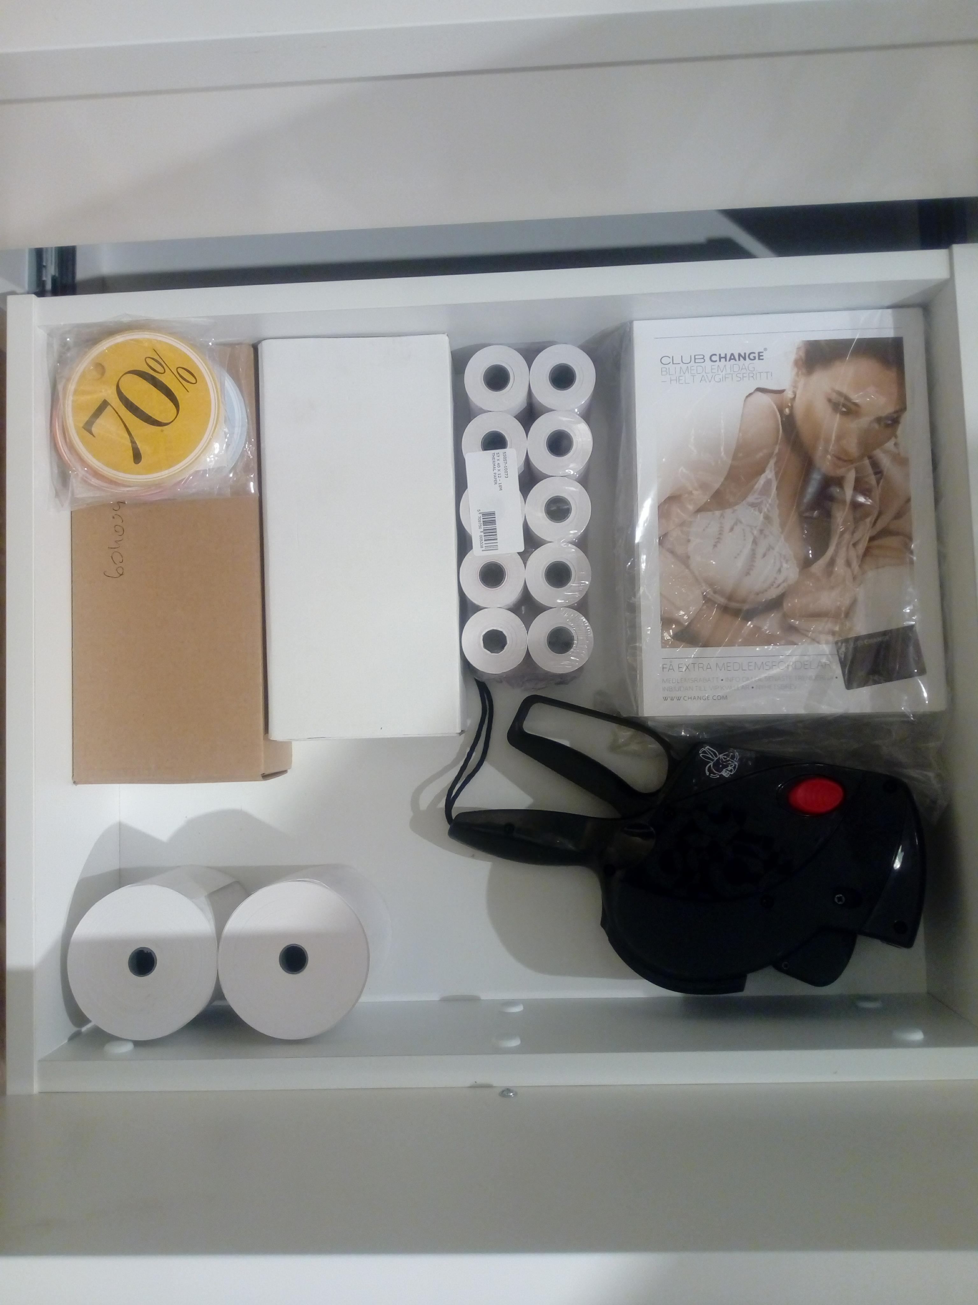
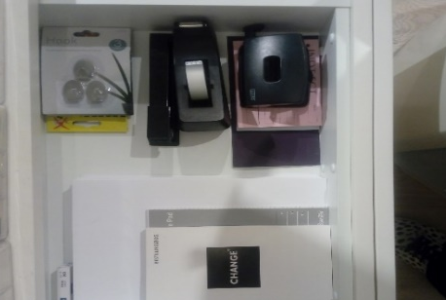
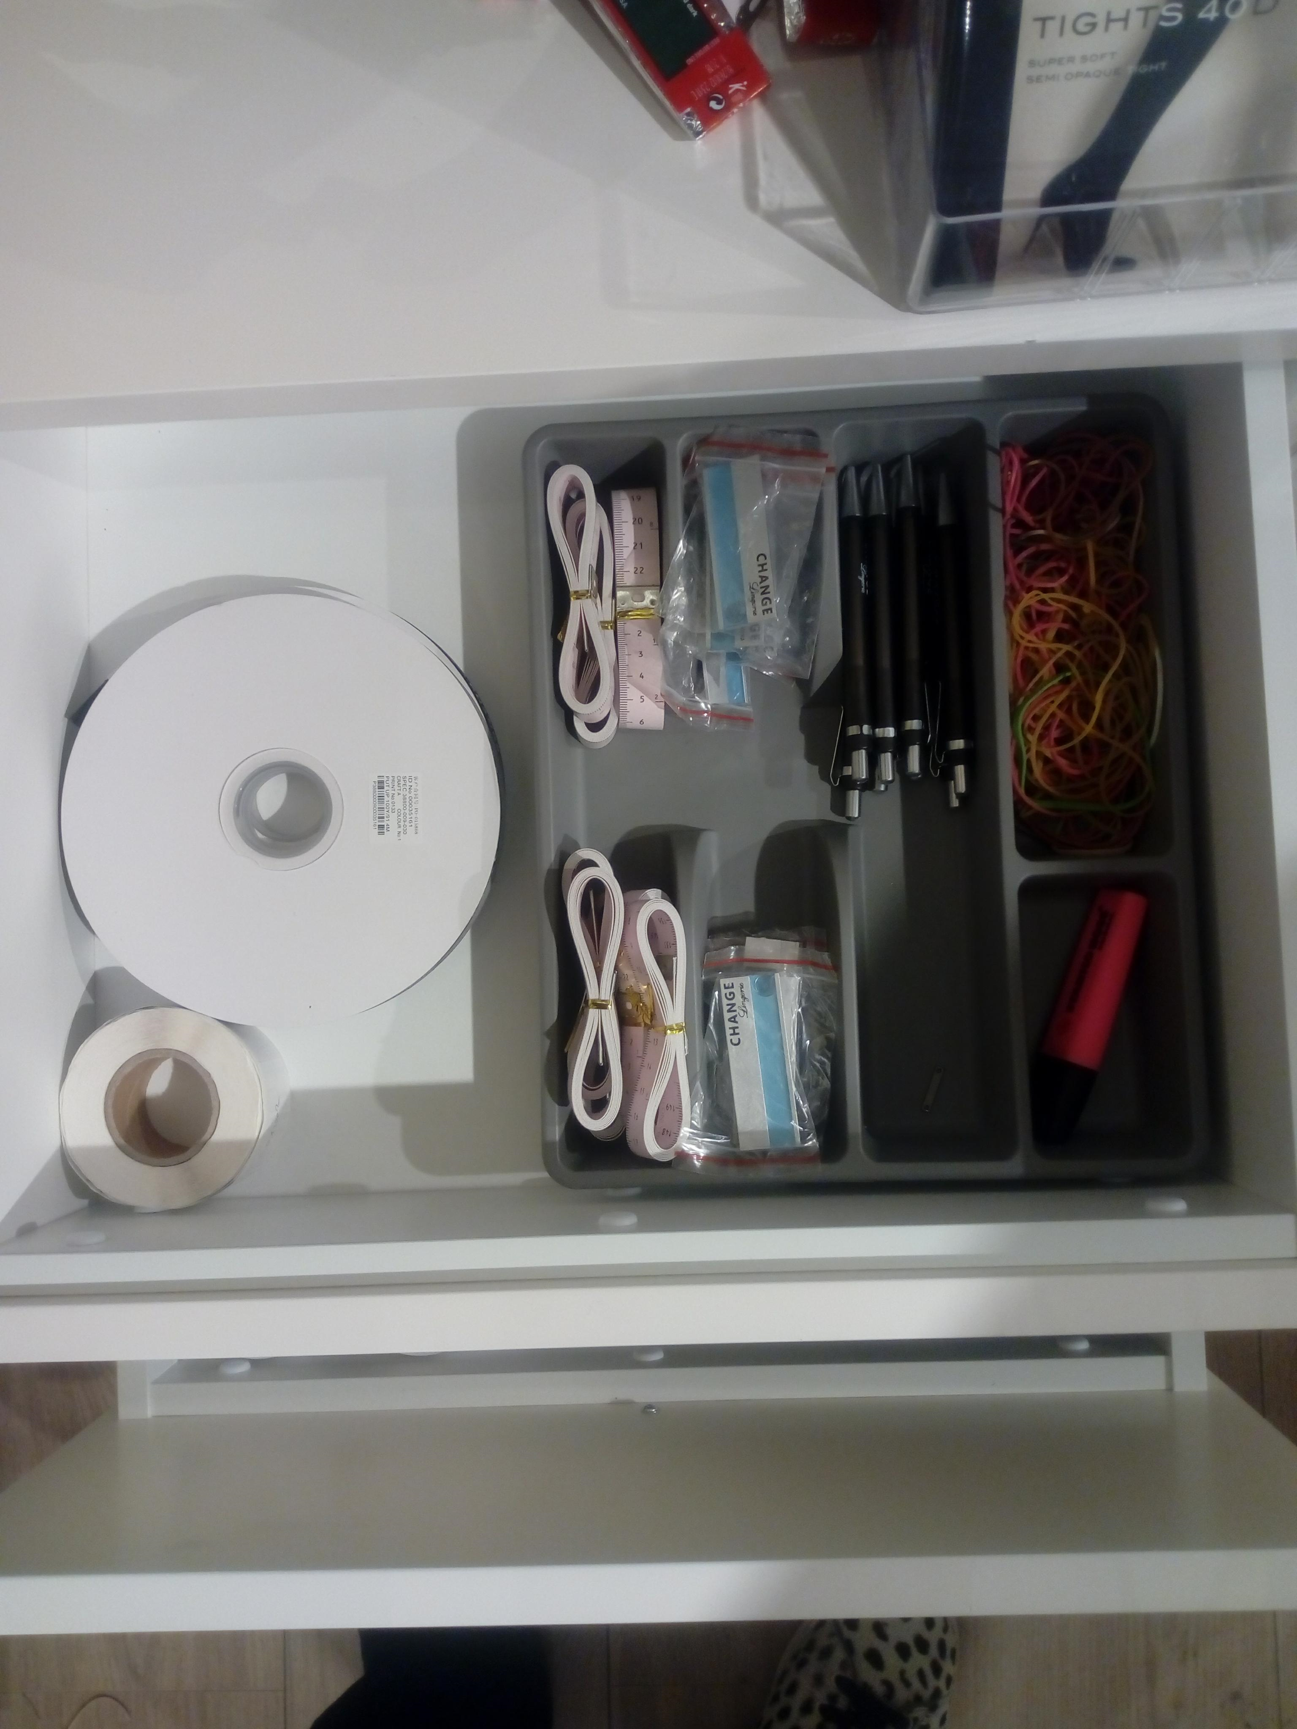
Office Drawers / Desk
Organize office drawers :
Take your cutlery tray and divide it into :
A room for pens and markers.
A room for measurement tape.
A room for nametags.
A room for stickers.
Make sure that your office drawers are always tidy and only consist of office / work relevant items.
Cash desk :
Make sure that you always have a clean and tidy cash desk.
The only item that should be visible at all times on the cash desk is the POS.
The keyboard should ( when not in use ) always be underneath the desk on the pull out drawer.
Make sure that you have a pen underneath the desk on the pull out drawer, so you don’t need to bend down to the drawer every time you need a pen.
Every time you have executed a deal with a customer, make sure that you put everything back to its right place.
The cash desk is the last Change experience for the customers, and we want to secure that that is as pleasant and professional as the rest of the Change experience.
12

Slide 13
Last things
Mare sure that all the straps are fitted correctly on the hanger and that all the bras are closed in the back.
That all products are on correct hangers.
Double check that you have the correct quantity per style displayed on the shop floor.
Make sure the hangtags on torso and mannequins are not visible
13

Slide 14
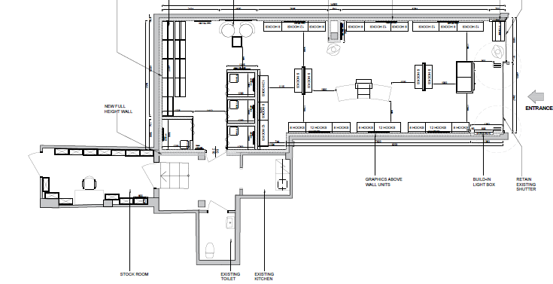
VM plan
Mannequins
Wardrope
Fitting room
A wall / Front table, see VM guidelines if no mark
Torso
Basic
CHANGE
Intimate
Charade
Nightwear
Swim
14

Slide 15

Walls
15

Slide 16
Walls
16

Slide 17
Walls
17

Slide 18
Walls
18

Slide 19
Walls
19

Slide 20
Walls
20

Slide 21
Walls
21

Slide 22
Floor module
22

Slide 23
Floor module
23

Slide 24
8 hook wall
24

Slide 25
12 hook wall
25

Slide 26
Floor module
26

